Slide 1

Optimizing Electric Vehicle (EV) Charging Station Placement in Madison
- Sandeep

Slide 2
Project Details
Client/ Customer – Vesla (An EV car company), new to the Automobile market.
Business Problem: Address the optimal placement of charging stations alongside meeting the demands of several zones within a specific budget and capacity in Madison, Wisconsin.
Objective: Installation of charging stations in the most cost-effective manner.
Decision Variables: Install Site, Serve Zone. (DV’s are binary).
Constraints: Demand coverage, Budget, Coverage capacity.

Slide 3

How does the MIP model help balance key factors?
Cost-Effective Decision Making:
It helps decide, where to place charging stations to minimize costs, ensuring that the total installation cost does not exceed the available budget.
Coverage of Demand Zones:
The model ensures that all demand zones (areas where electric vehicles need charging) are adequately served by charging stations.
Optimal Resource Allocation:
It accounts for station capacity and ensures that no station is overloaded trying to serve too many zones.
Realistic Constraints:
It simulates real-world scenarios considering distance, where charging stations should be within a reasonable range of the demand zones.

Slide 4

Inputs & Parameters
Candidate Sites: These are the potential locations where we can install charging stations. We have 5 candidate sites (i.e., 1, 2, 3, 4, 5).
Demand Zones: These represent the areas that need charging stations. We have 10 demand zones (i.e., 1, 2, 3, 4, 5, 6, 7, 8, 9, 10).
installation_costs: The installation cost for each candidate site (1 for each site).demand: This represents the demand for charging stations in each of the 10 demand zones.
Capacity: The capacity of each station, i.e., the maximum demand that a station can serve.
Budget: The total available budget to install the stations. The cost of installing stations cannot exceed this value.
Distance: The distance a charging station can be, from a demand zone to cover it.

Slide 5
Installation Costs = [120, 100, 150, 110, 200] # Costs for sites
Demand = [90, 110, 150, 80, 120, 200, 140, 160, 100, 90] # Demand for zones (10 zones)
Capacity = [300, 250, 350, 200, 400] # Capacity of each station
Budget = 1000 # Increased budget for testing
Distance = 20 # Relaxed distance limit to allow more coverage
distances = [[5, 8, 10, 12, 6, 15, 9, 10, 7, 11], # Site 1; [10, 5, 12, 8, 9, 14, 6, 9, 8, 12], # Site 2;
[12, 11, 6, 10, 7, 13, 8, 12, 9, 10], # Site 3; [15, 14, 9, 7, 10, 12, 11, 16, 14, 13], # Site 4
[8, 6, 10, 5, 7, 10, 8, 9, 6, 10] # Site 5
Decision Variables:
Install Site[i]:
"Whether to install a charging station at candidate site i."
Serve Zone[i, j]:
"Whether the charging station at site i serves demand zone j."

Slide 6

Constraints:
Demand Coverage:
It ensures that each demand zone is covered by at least one station. It checks that the sum of all candidate sites are within the distance from the demand zone is at least 1.
Capacity:
It ensures that the total demand served by one station does not exceed its capacity.
Budget:
This ensures that the total installation cost does not exceed the available budget. The sum of the installation costs for all selected sites must be less than or equal to the budget.

Slide 7
Objective and Solver
The objective function is to minimize the total cost, which consists of two components i.e., Installation Costs and Unmet Demand.
If a station does not cover a demand zone, it will be penalized hence uncovered demand contributes to the cost.
We create a solver using the CBC solver. This is an open-source solver for mixed-integer programming problems.
Time Limit: Establish a time limit of 300 seconds (5 minutes) for the solver.
Prevent Infinite Run: Ensure the solver does not run indefinitely.
No Optimal Solution: If the solver does not find an optimal solution within the time limit, it means no optimal solution exists for the given inputs and constraints of the Mixed-Integer Programming (MIP).
Global Optimal Solution: If the solver finds a solution within the time limit, it is considered the Global Optimal solution.

Slide 8
Global Optimal
Demand
Zones Covered:
Site 1
Serves Demand Zones (7, 8)
Site 2
Serves Demand Zones (3, 9)
Site 3
Serves Demand Zones (1, 2, 3)
Site 4
Serves Demand Zone 6
Site 5
Serves Demand Zones (2, 4, 5, 10)

Slide 9
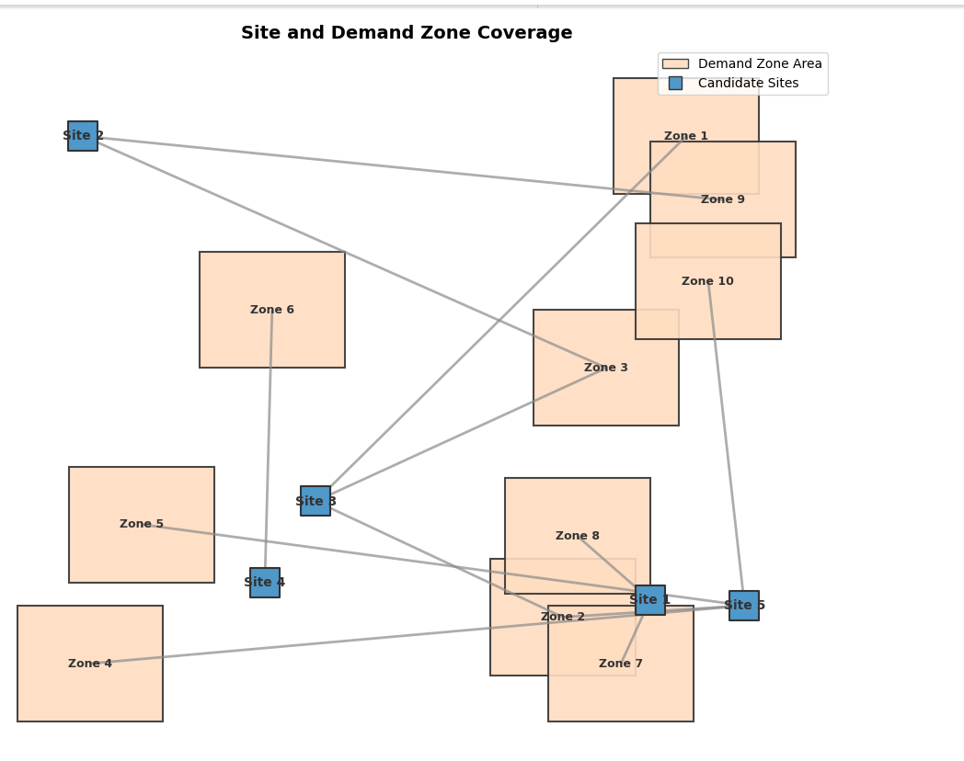

Slide 10


